Slide 1


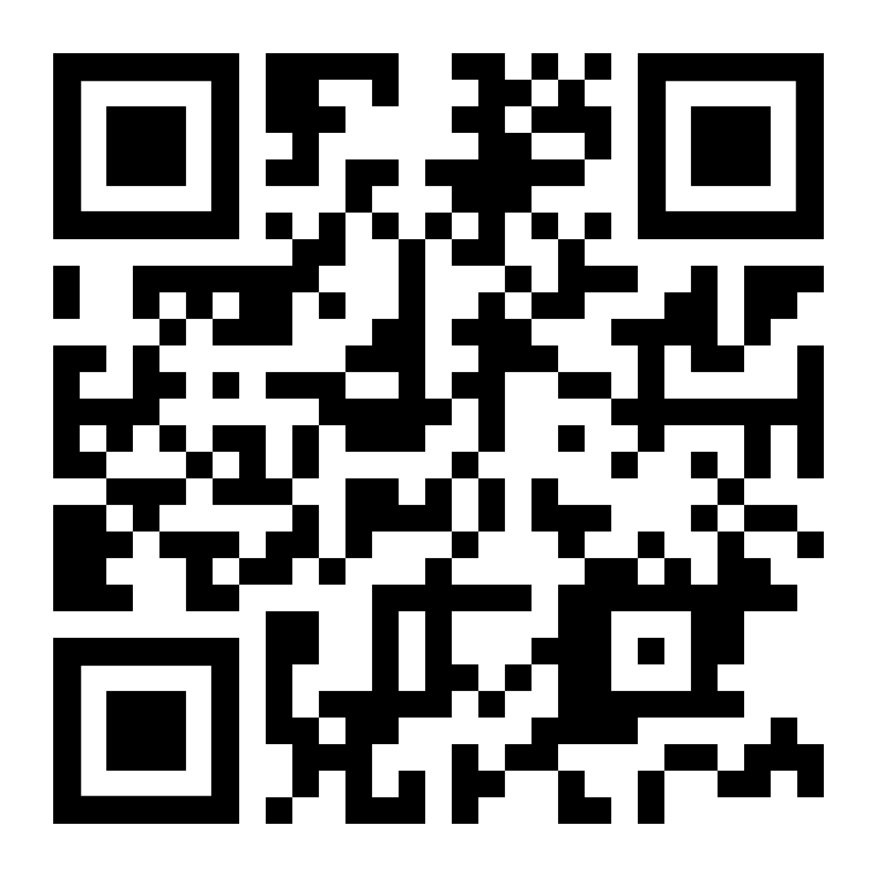

Two manufacturing programs MADE FOR YOU.
SELF-PACED
HYBRID LEARNING
FLEXIBLE LABS
1 CREDIT
AT A TIME
Computer
Aided
Manufacturing
Industrial
Automation
This workforce product was funded by a grant awarded by the U.S. Department of Labor's Employment and Training Administration. The product was created by the recipient and does not necessarily reflect the official position of the U.S. Department of Labor. The Department of Labor makes no guarantees, warranties, or assurances of any kind, express or implied, with respect to such information, including any information on linked sites and including, but not limited to, accuracy of the information or its completeness, timeliness, usefulness, adequacy, continued availability, or ownership. This product is copyrighted by the institution that created it.
This work is licensed under the Creative Commons Attribution 4.0 International License. To view a copy of this license, visit http://creativecommons. org/licenses/by/4.0/ or send a letter to Creative Commons, PO Box 1866, Mountain View, CA 94042, USA
Get
started
today!
NorthwestState.edu/scc

